Slide 1

sYSTEM INNOVATION: MAIN MESSAGEs
Directorate for Science, Technology and Innovation, OECD
Climate transitions through innovation
18 June 2015
Notes:
Nix!

Slide 2
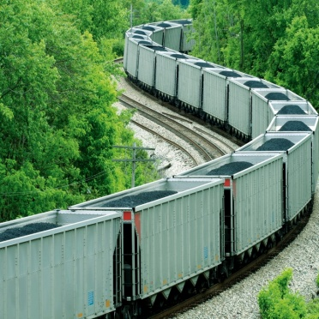





System innovation : main messages
Defining the concept
Relevance of the concept today
Examples of barriers to transitions
Lessons from case studies
Policy Implications

Slide 3

1. Defining the concept
System innovation is a horizontal policy approach to tackle problems that are systemic in nature; it involves actors outside government and is longer term in its planning
It involves:
Fundamental social, technical, political
and institutional change;
Shared visions and co-operation is needed
to redesign socio-technical systems –cannot be
dictated by central government
Removal of barriers to radical innovations that are held back due to unsupportive institutions or market and regulatory barriers

Slide 4




2. Why is the concept relevant?
Today’s societal challenges involve complex systems: Climate; Ageing, Energy, Unemployment etc.
Technological inter-dependencies and “chicken-egg problems” : example of electric vehicles versus infrastructure

Slide 5

3. Barriers that hinder transitions (1)
Framework conditions: If innovative firms cannot grow and challenged incumbent firms cannot exit, structural change is held back.
Basic research: Challenge driven research funding, co-operation with industry, but scientific excellence remains the single most important metric
Business innovation: Fiscal support for R&D may be misaligned but financing gaps for commercialisation are equally important
Horizontal /vertical governance: Devolution of innovation policies to cities and regions demands greater co-ordination to avoid misalignment

Slide 6
Case study 1 : Bio-economy in the NL
Non-innovation policy obstacles:
Lack of certification
Import levies for green feedstock
Lack of level playing field between
different biomass policies
Responses:
Dutch policy program to remove or limit any obstacles in regulation
Dutch program ‘Green deals’: projects of business and government,
for instance new certification of bio-plastics

Slide 7
Case study 2: E- mobility in Austria
The challenge:
Requiring (or inducing) changes respectively integration in the
mobility system as such (use
patterns, user practices)
not only an incremental innovation
not only related to technological challenges
Requires integration in the energy system
Requires new infrastructures, thus ‘systemic’
Requires involvement of different stakeholders and policy fields
Figure : number of newly registered EVs in Austria per month

Slide 8

5. Policy Implications (1)
Policy makers’ clear understanding of the systemic nature of problem and their role for instituting changes;
Transition management and participatory approaches require time, consistency and stability in policy direction.
Understanding and managing resistance to change is a key role of policy.
Need for new administrative capabilities and new needs for co-ordination across governments and in innovation eco-systems.
New framework conditions to shift incentives in the desired direction (law, regulations) and market mechanisms such as prices.

Slide 9
5. Policy Implications (2)
Minimise the risks of policy failure associated with picking winners and technological lock-in.
Supporting a broad portfolio of support to tech and non-tech innovations (i.e. the low hanging fruit) to reduce risks but loss of directionality?
Infrastructure – renewal and creation of new infrastructure
Governance requires both the mobilisation existing policy frameworks and instruments and the creation of new one
Long-term policy strategies, with a defined roadmap.
Policy targets with great indicators and standards.

Slide 10

Thank you!
Mario.cervantes@oecd.org
Save the date !

